Slide 1
Concepts for Coding Efficiently
Liam Berrisford

Slide 2
Origins of the course
We need a computer scientist on the team!

Slide 3
Origins of the course
We need a computer scientist on the team!
We need someone knowledgeable of computer architecture, and data structures and algorithms on the team!
(not quite as catchy ☹ )

Slide 4
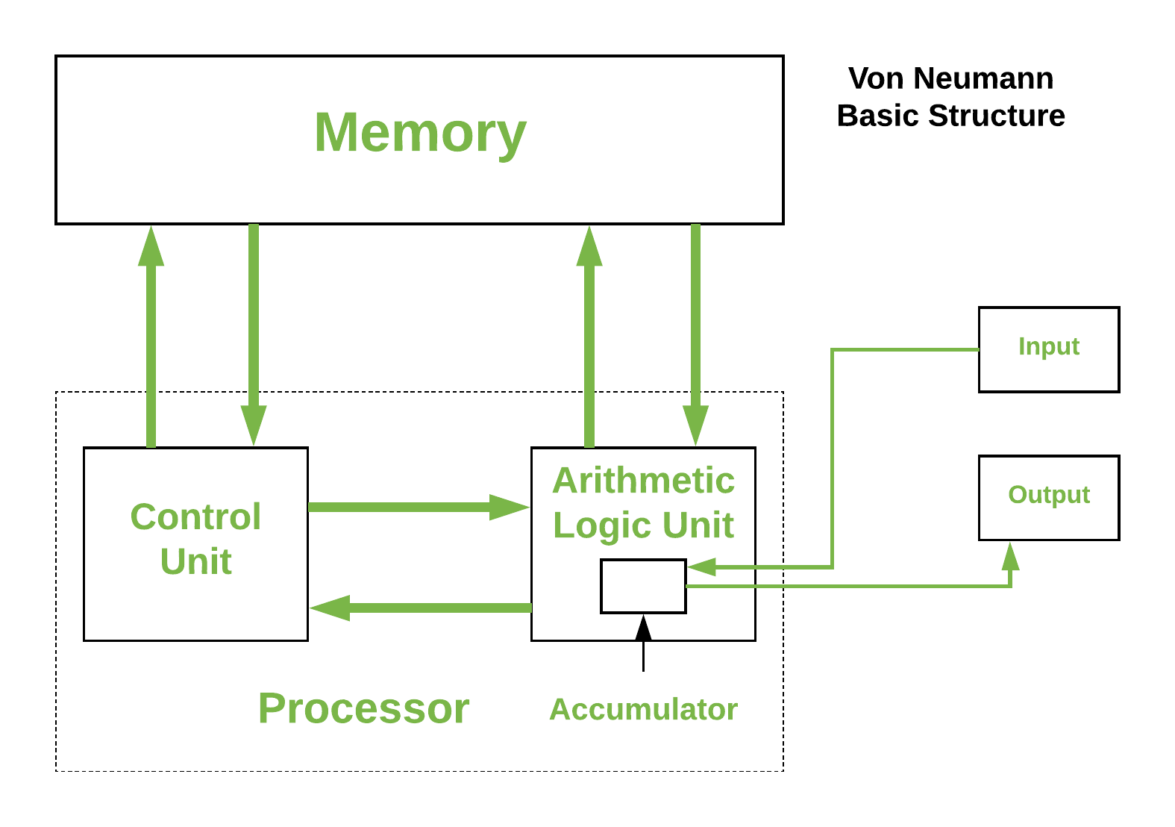
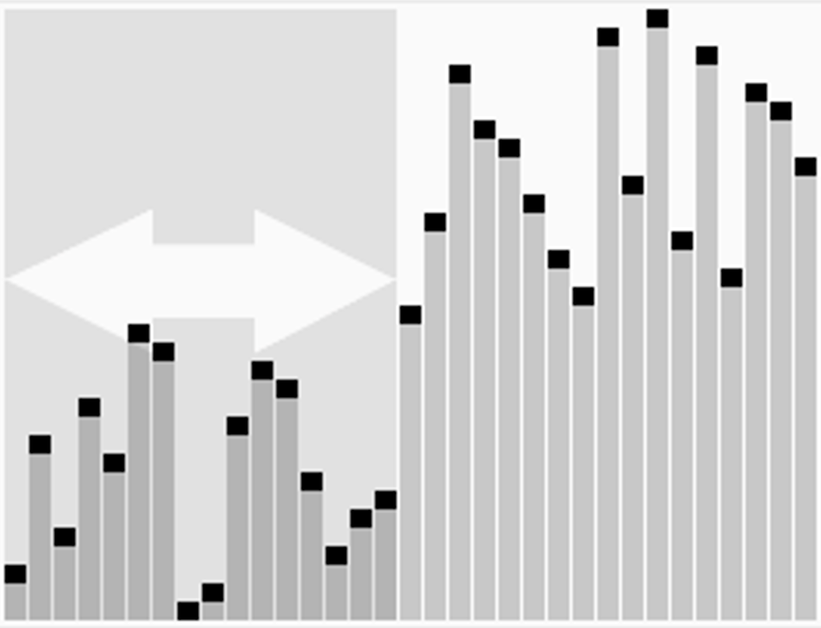
Computer Architecture
Data Structures and Algorithms

Slide 5
Course Aim…
To give an intuition and deeper understanding of what happens when you run code.
Allowing you to make informed choices
Most other courses I have seen tackle this issue take the approach
Explain how to use dask etc,
This course won’t teach any implementation
But give you the confidence to understand and learn dask or any other flavor of the week

Slide 6
Overall Goal: Understand what the computer is spending time doing when running code and how to optimize the time spent on different steps.

Slide 7
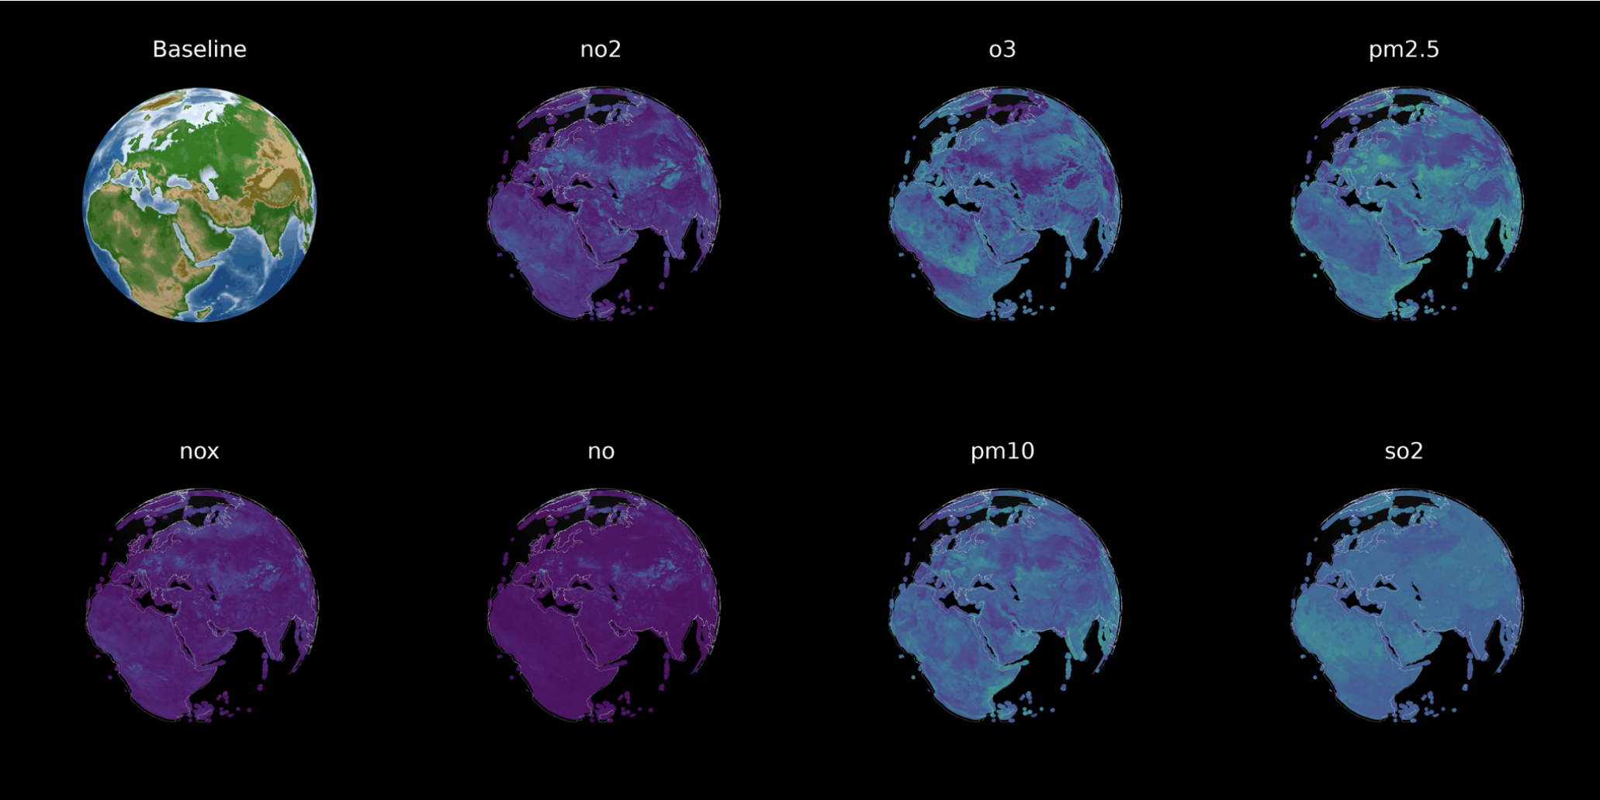
Why these concepts are important
In my own research….

Slide 8
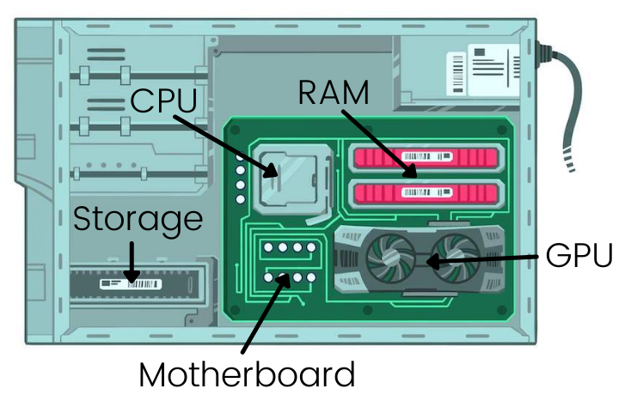
What makes a pc?

Slide 9
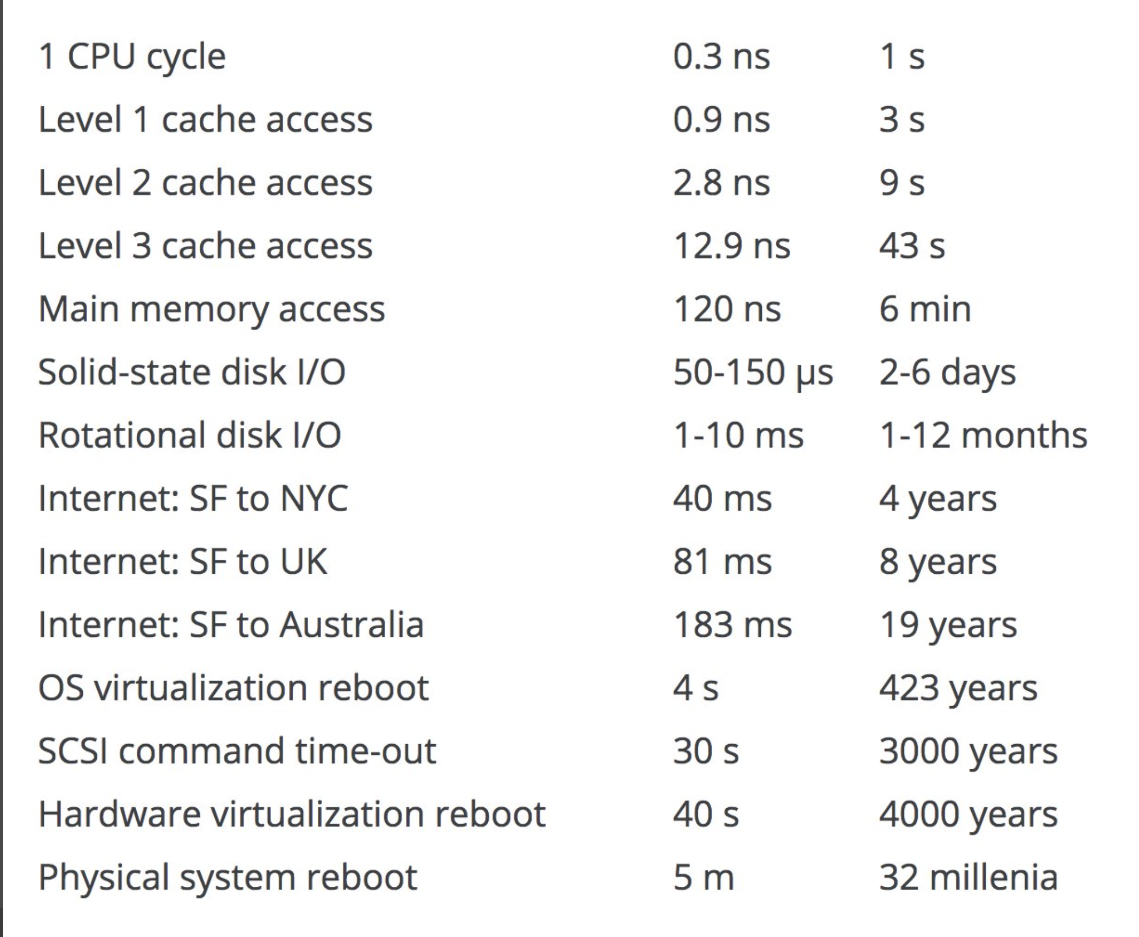
Latency Times everyone should know

Slide 10

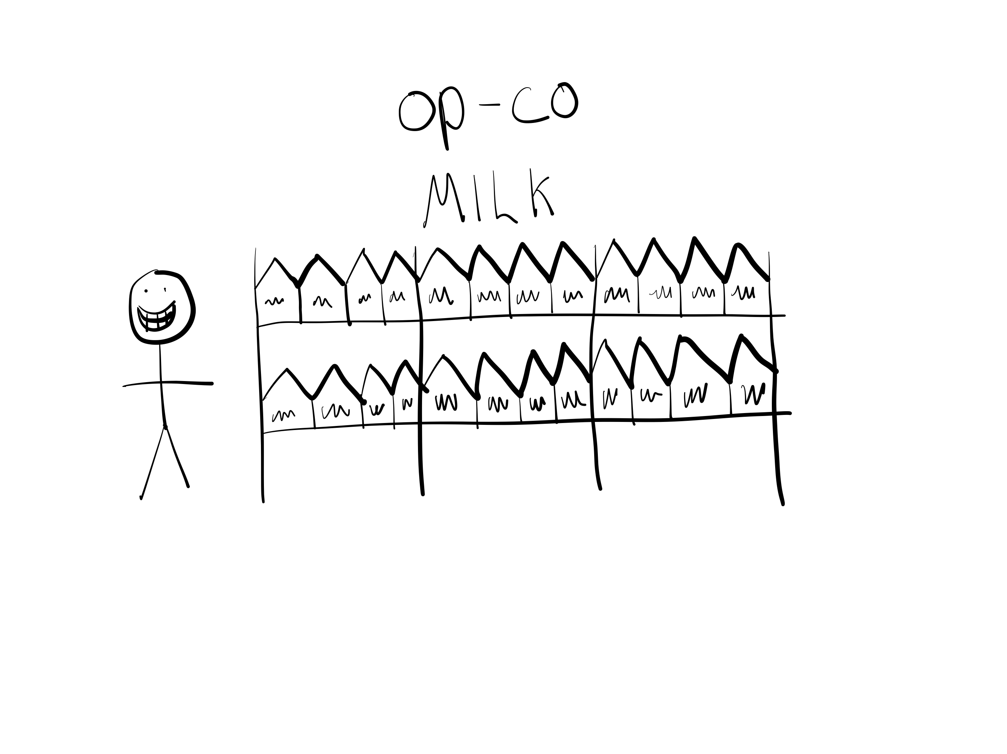
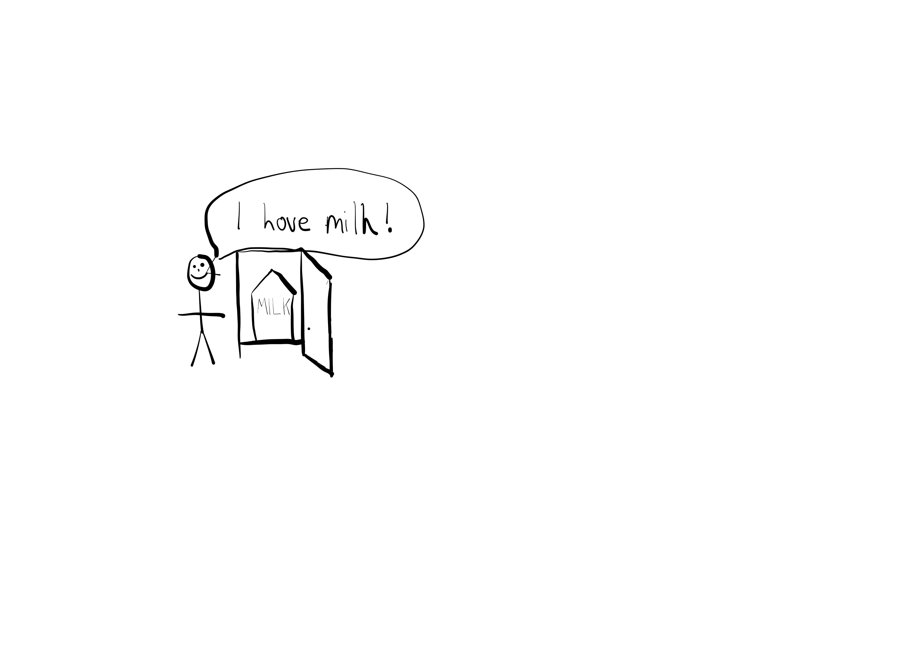
Three main ones to remember
CPU Cache
RAM
Disk
Where computation is performed
Where data is stored ready for computation
Where all data is stored

Slide 11
Basic Process for Data Science
Some data is stored in the storage
You load it in (with pd.read_csv()) to the RAM
You perform some processing on the data in Ram
E.g. .apply() for each row
Data gets loaded into the CPU cache, modified, and sent back to RAM and new data loaded into the cache
Eventually the data is moved from RAM to storage through pd.to_csv()

Slide 12
What relation does this have to do with code?
The programmer is involved with disk -> RAM explicitly
The programmer is involved with RAM -> cache, and cache -> RAM implicitly
There are many implications of the code that you write that you don’t see directly.
We want to focus on these implicit aspects of what we are doing, understanding the code transfers internally

Slide 13
Analysis of Algorithms
Interested in two resources
Running time
Memory space
We are going to focus on running time, not memory space, but the principles are the same!
However, how do we compare two algorithms that might be on different PCs?
Can we use clock time?
My algorithm takes 5 minutes,
Your one takes 2 minutes

Slide 14
Issues with wall time
What are the issues with wall time (e.g. count the seconds to run from starting)?
Dependence on the speed of a particular computer
Dependence on the quality of the program implementing the algorithms
Dependence on the quality of the compiler used to generate
The difficulty of clocking the time precisely
Other things are running on the PC!

Slide 15
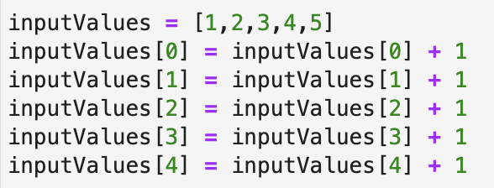
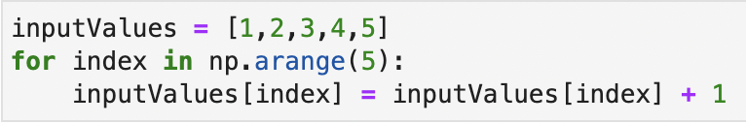
Counting Basic Operations in Algorithms
Therefore define the performance of an algorithm with a hypothetical machine (the random access machine!)
Each simple operation (+, *, -, /, =) takes 1 time step
For loops are counted as an expression of multiple simple operations
Why is it important?
Consistency
Always take into account the input size

Slide 16
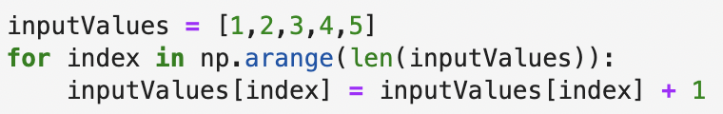
Example Counting
REMEMBER
(+, *, -, /, =)

Slide 17
Example Counting
10 Operations are carried out

Slide 18
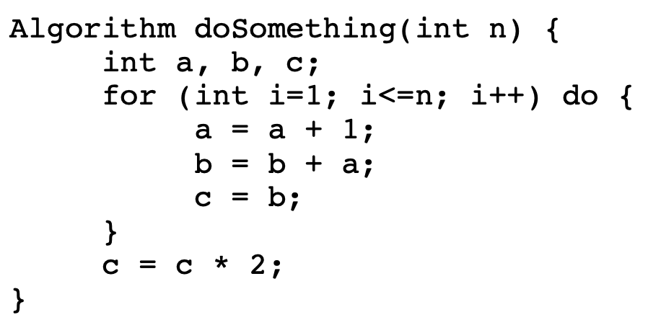
Get into pairs and try to count the steps!
REMEMBER
(+, *, -, /, =)

Slide 19
From 1 -> 5
Therefore runs 5 times
T(n) = 5n + 2

Slide 20
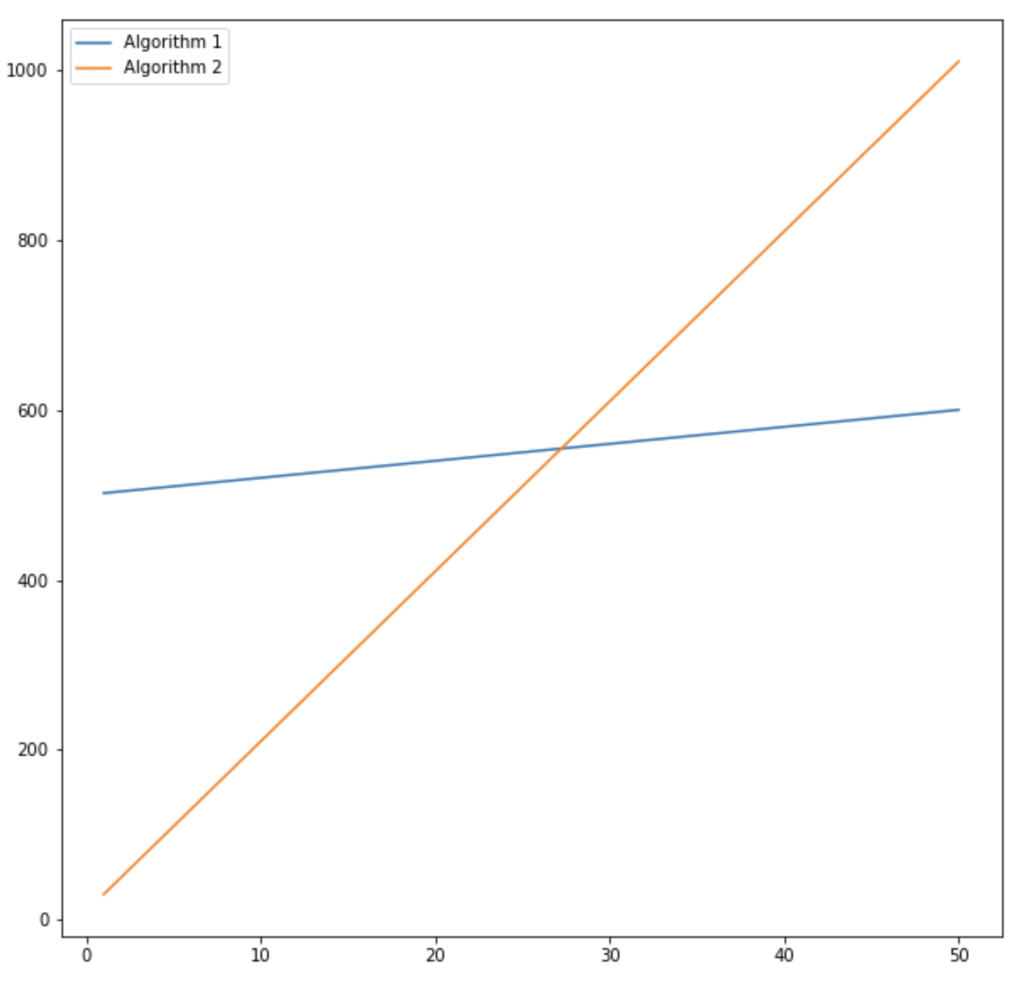
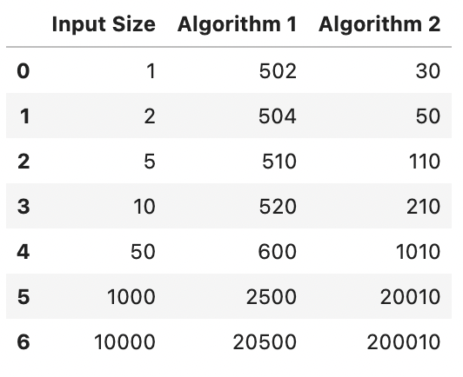
Take two algorithms, which is better?
Algo 1 : T(n) = 2n + 500
Algo 2 :T(n) = 20n + 10

Slide 21
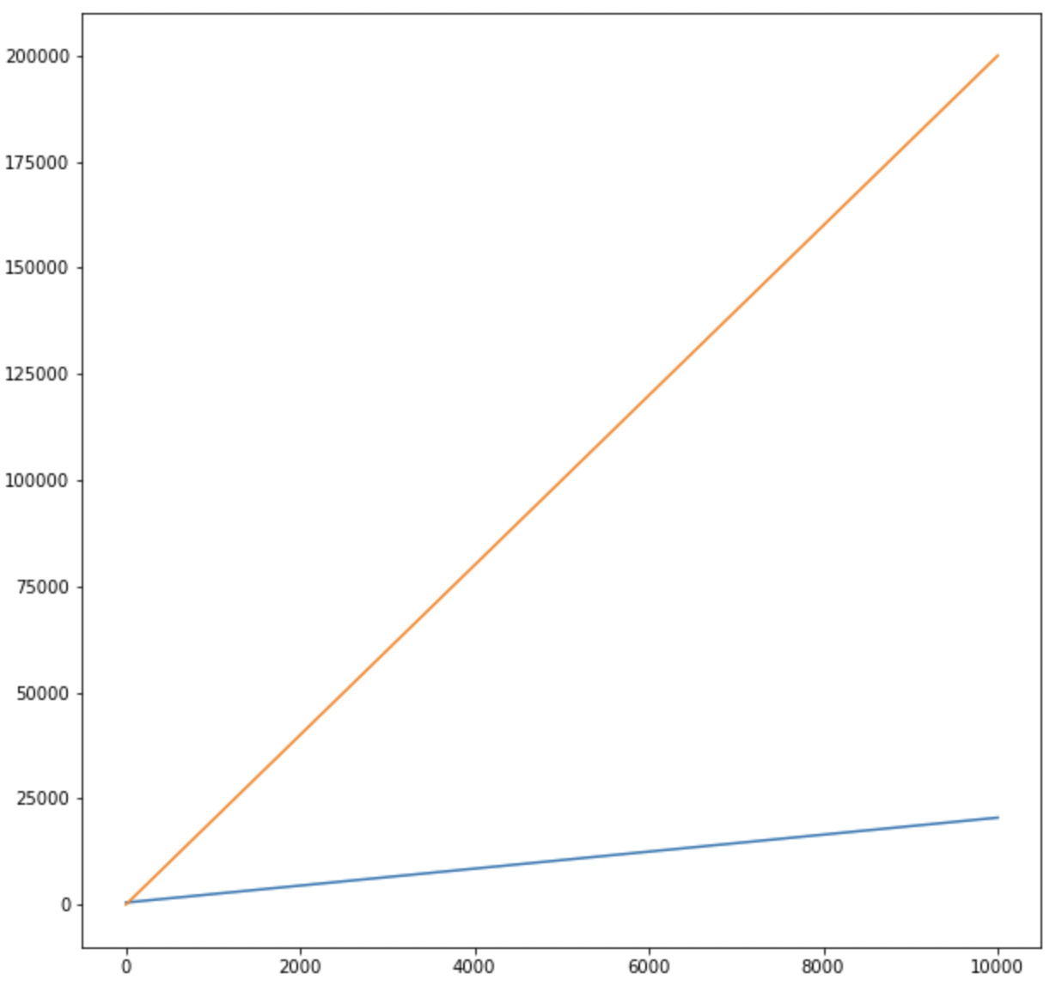
However,
Algo 1 : T(n) = 10n + 11
Algo 2 :T(n) = 5n + 100
However, we say both have O(N) time complexity or are a linear algorithm

Slide 22
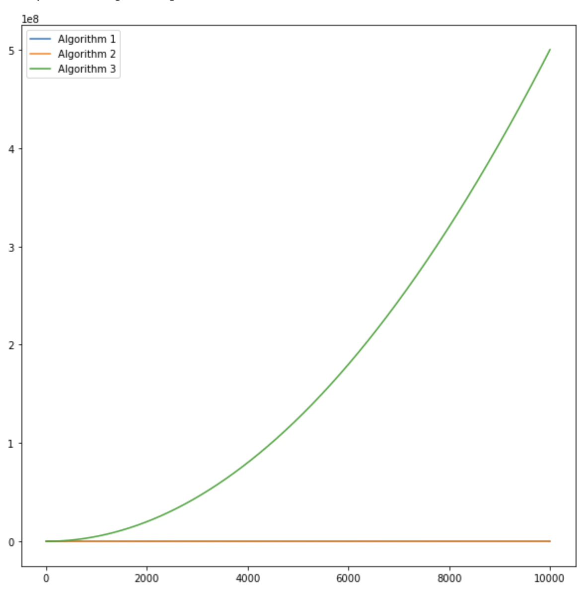
However
Algo 1 : T(n) = 2n + 500
Algo 2 :T(n) = 20n + 10
Algo 3 :T(n) = 5n^2 + 10
Algo 1 : O(N)
Algo 2 : O(N)
Algo 3 : O(N^2)

Slide 23
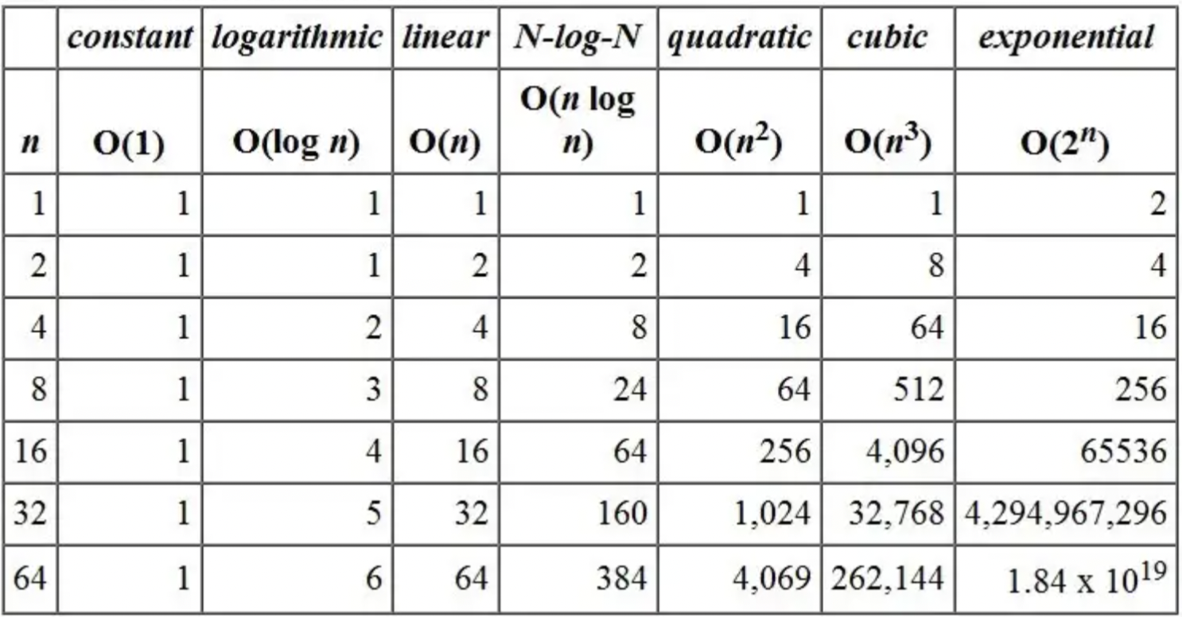
Orders of Magnitude

Slide 24
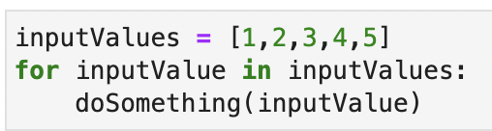
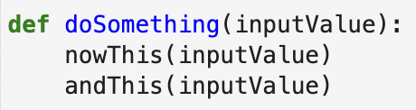
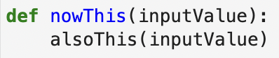
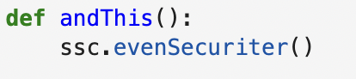
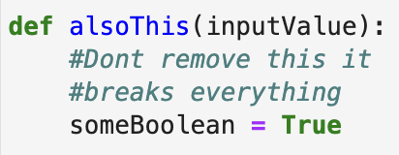
What's the difficulty with counting the steps in this code?

Slide 25
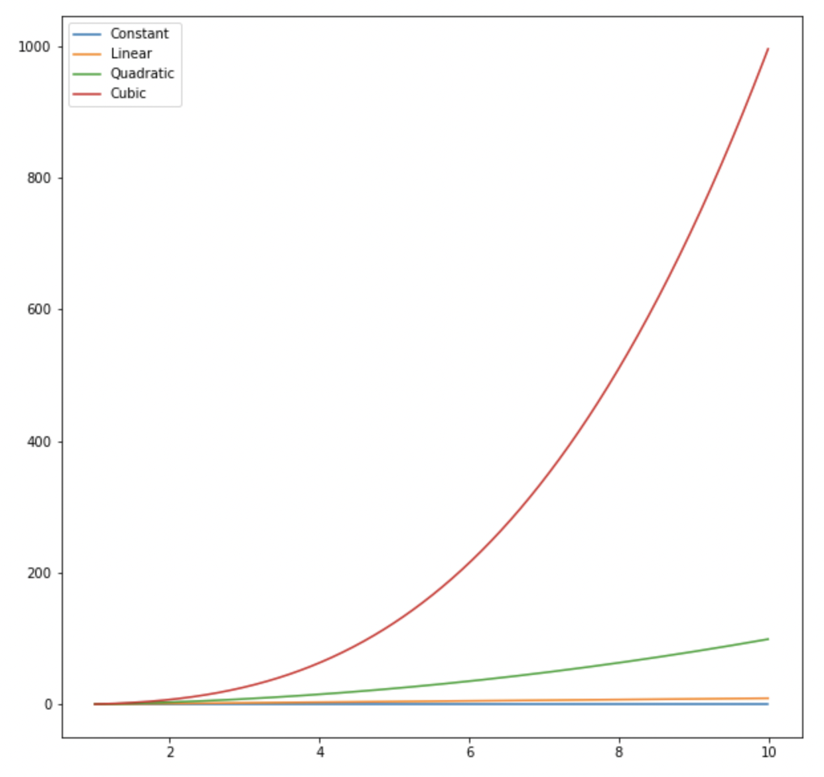
Empirically determine the time complexity for an unknown function
You can determine the complexity with some experiments
E.g. try for input size 1
Then 5
Then 50
Then 100
And build a graph and compare

Slide 26
Try exercise_1_empiricalAlgorithmicComplexity
The function doSomething will return the number of steps for the computation when given an input size
E.g. Inputting input size 1, will return 103, indicating 103 computation steps for an input size
Try inputting different values, e.g. 10 and then plot
Keep the values below 10

Slide 27
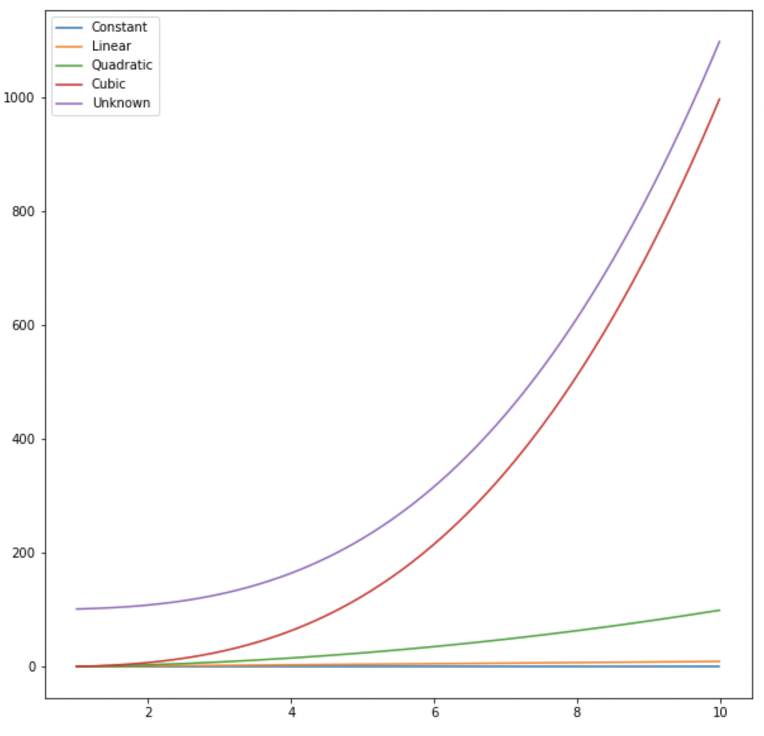
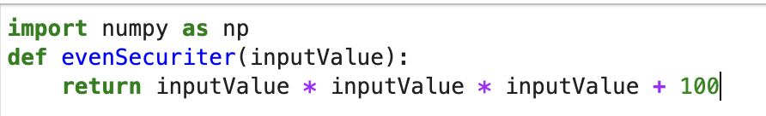
Exercise 1 Answers
Code

Slide 28
Exercise 1 Answers
Code
T(n) = n^3 + 100
O(N^3)

Slide 29
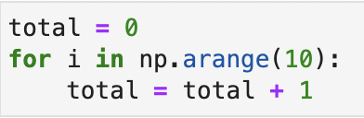
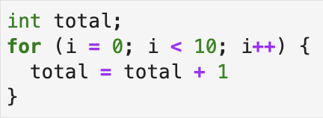
Strongly and Weakly Typed languages
Python Code
C Code

Slide 30
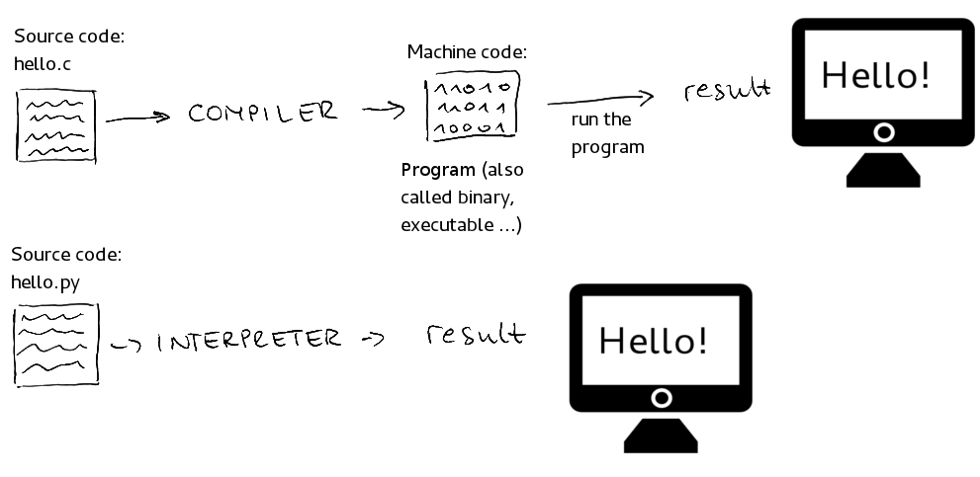
Compiled and Interpreted Code

Slide 31
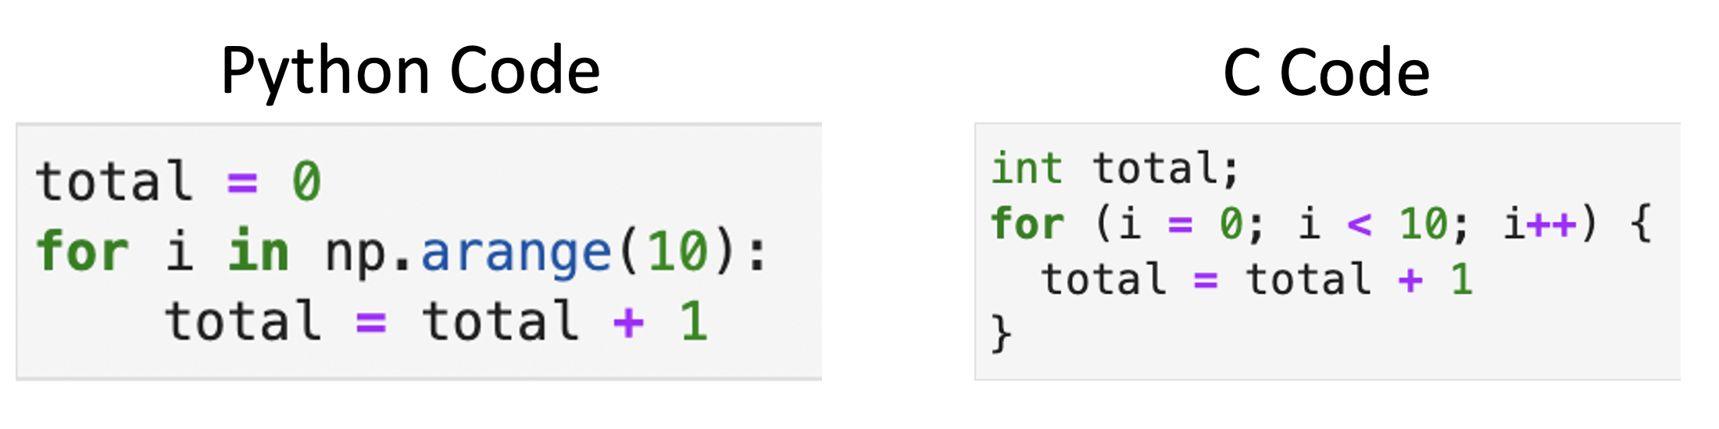
What are the differences when running the codes for interpreted and compiled and strongly and weakly typed?

Slide 32
Fewer checks
Weakly typed code has to check all data types all the time
Strongly typed know what data type it should be and can pick up errors earlier
Reduce computation step during run time
E.g. python code needs to be turned to machine code for each line one by one

Slide 33
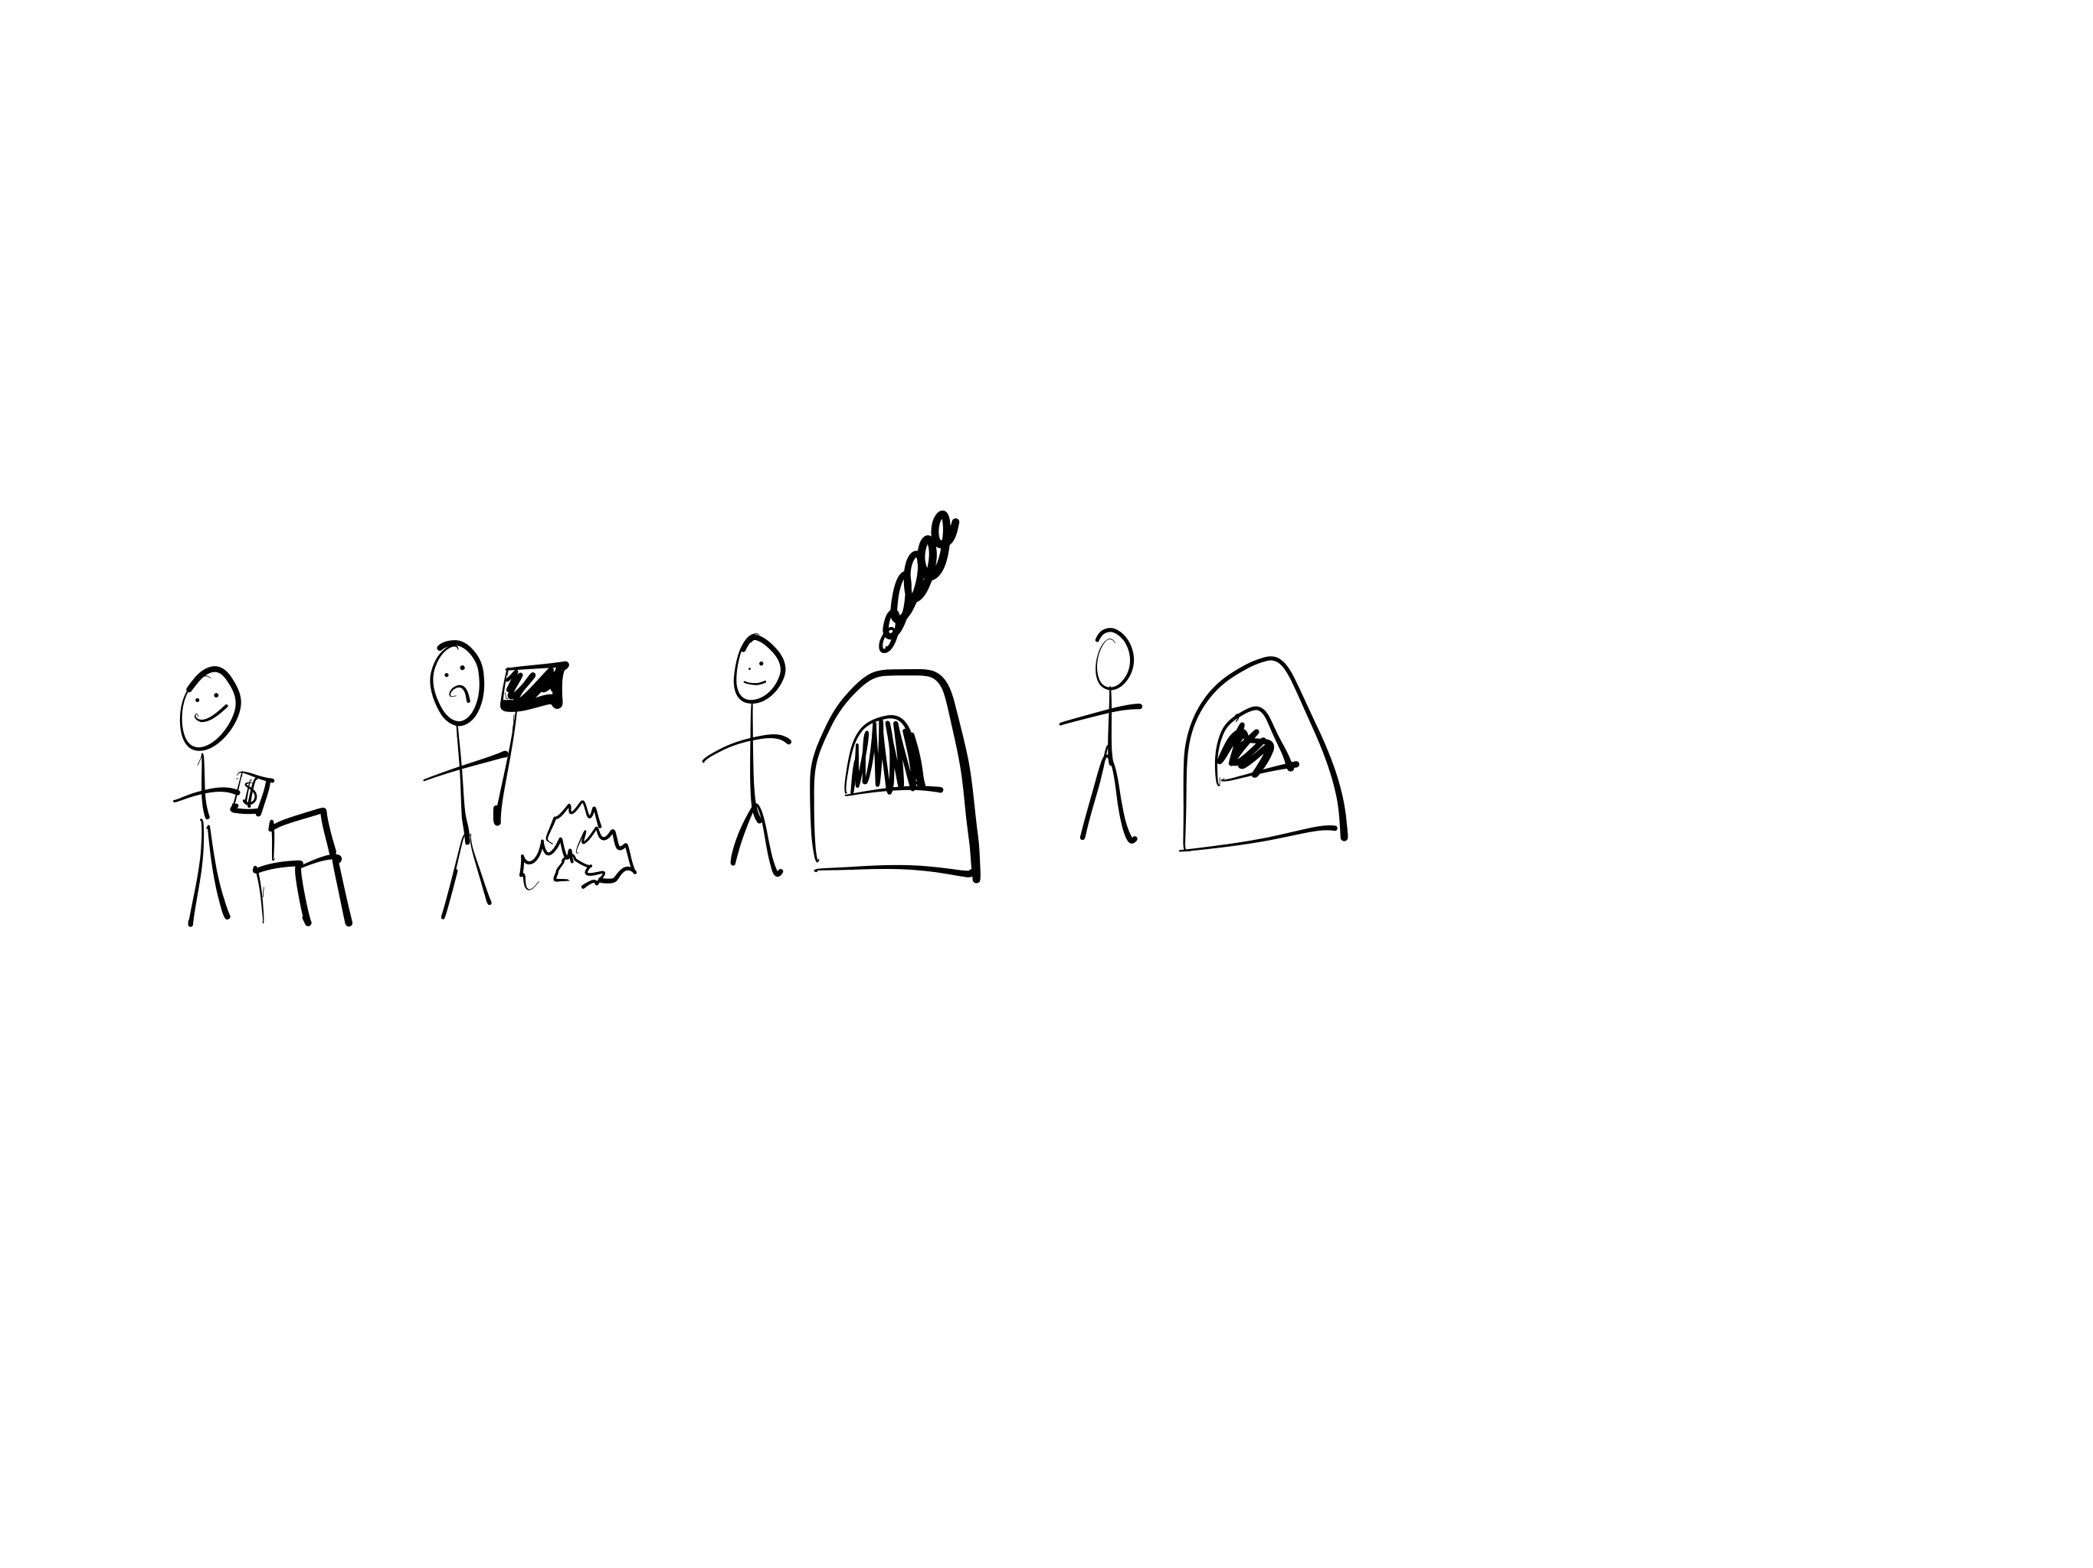
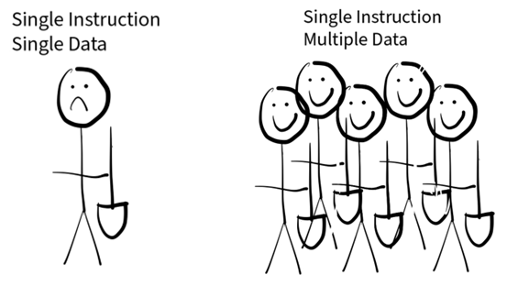
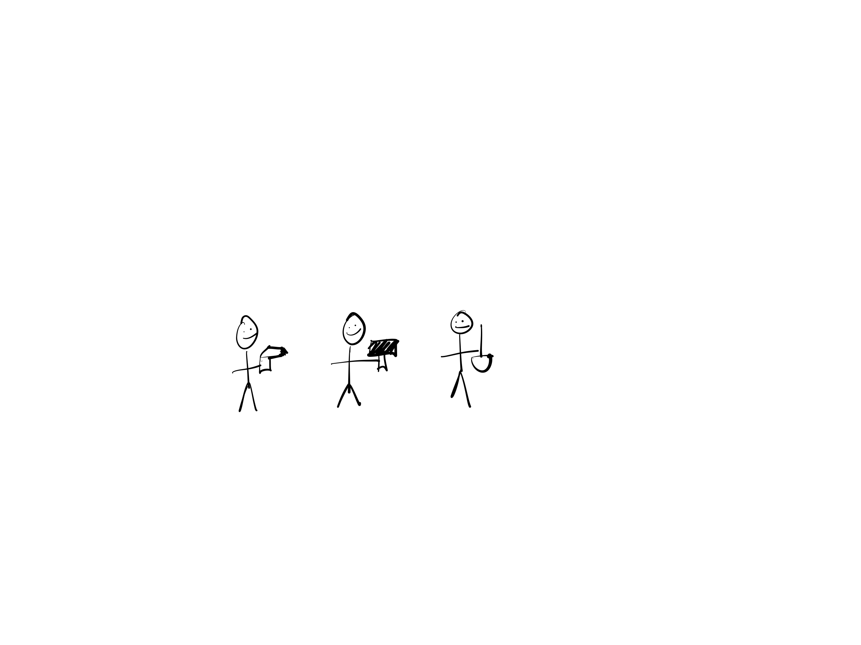
Flynn's Taxonomy
Instruction Stream
Single
Multiple
SISD
MISD
Single
Data Stream
SISD
MIMD
Multiple

Slide 34
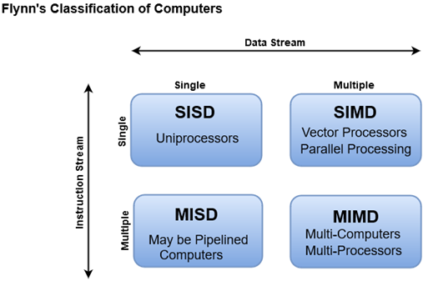

Slide 35
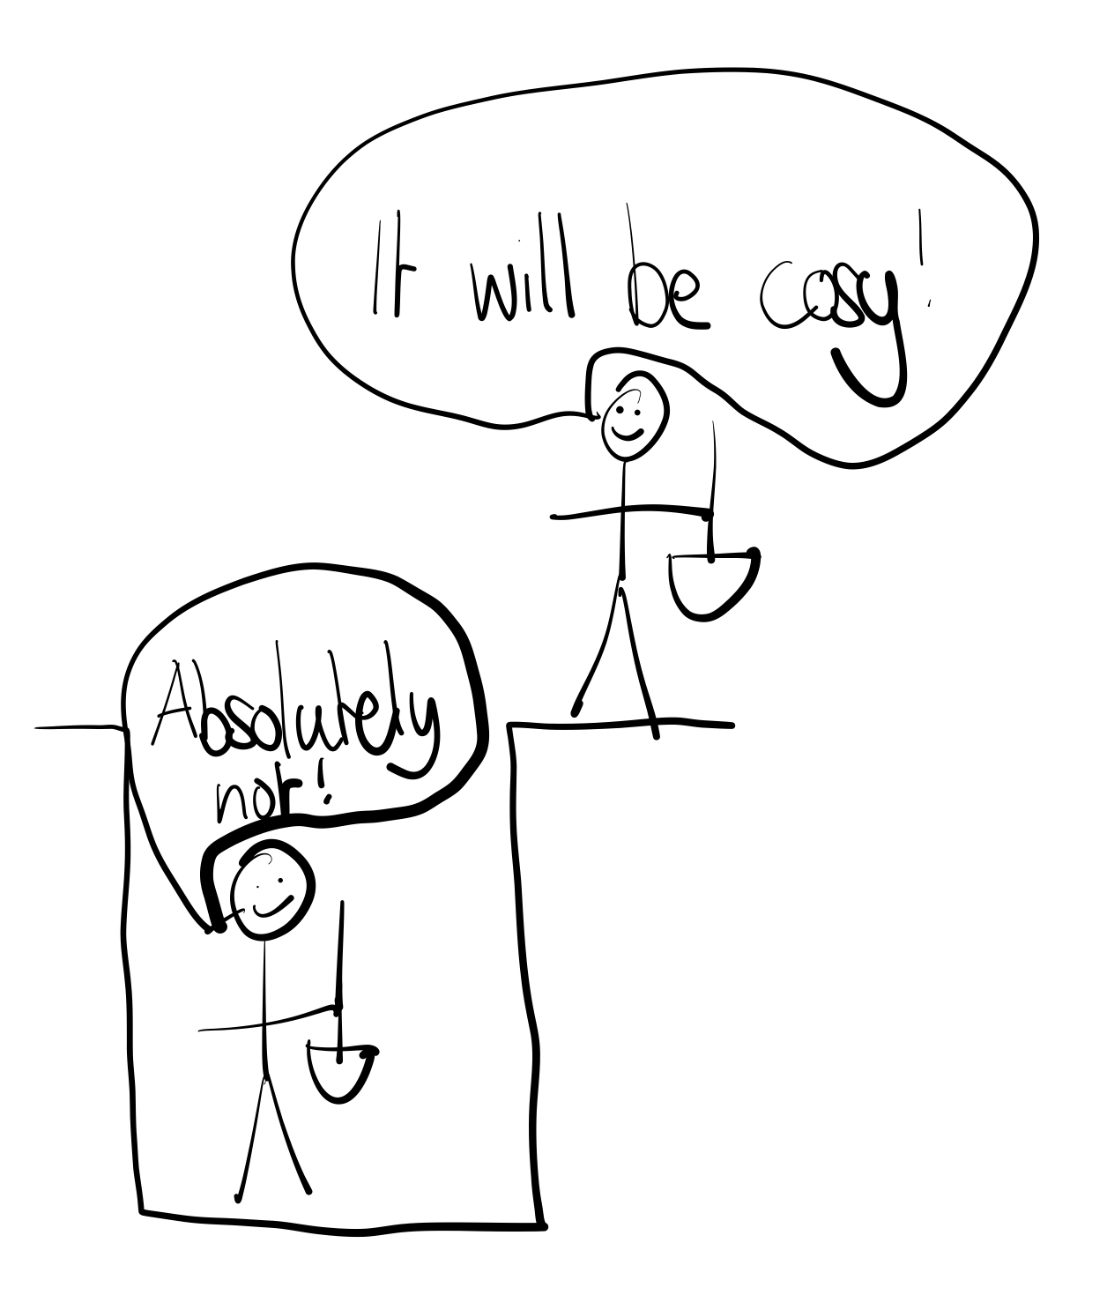
Sequential Code
Only one person can dig a hole, can't dig the soil of 5-10m and another 1-5m.
However, some sequential code can be parallelised….

Slide 36
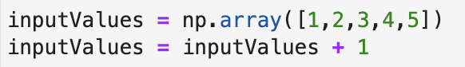
What has changed?

Slide 37
What has changed?
Single Instruction, Single Data
Single Instruction, Multiple Data
The process of moving from SISD to SIMD is called vectorisation!

Slide 38
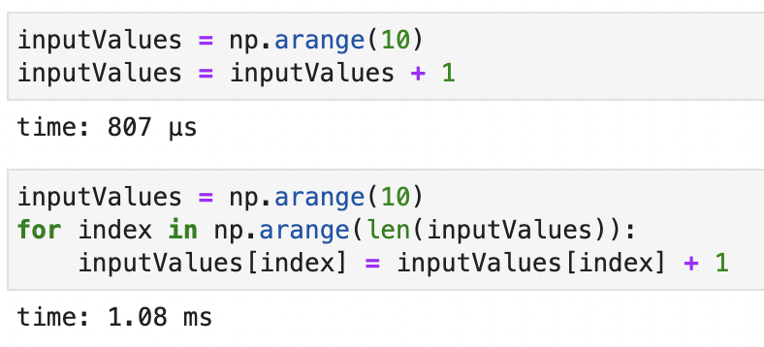

Slide 39
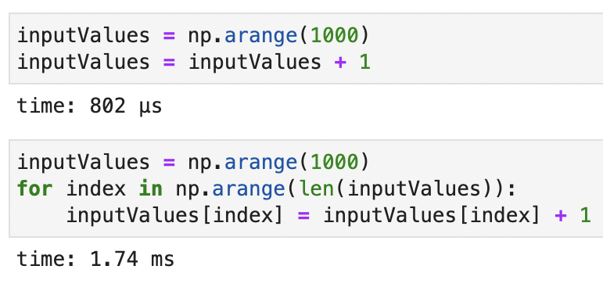

Slide 40
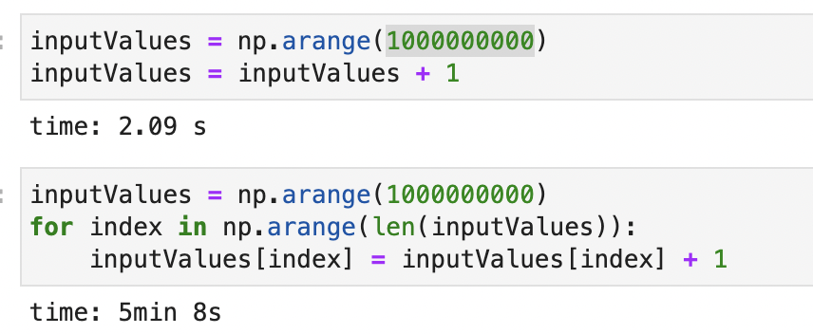

Slide 41
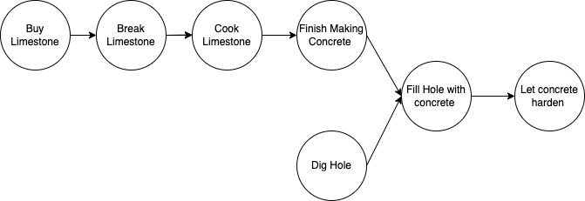
Making a computation graph
For example, let’s say we dig a whole and want to fill it with concrete; the computation graph for this might look like

Slide 42
Making your own computation graph
We are going to build a house
Come up with your own computation graph in pairs (doesn’t have to comply with regulations!)
Do you lay foundations before the walls?
At what stage can you do the roof? Do the walls need to be finished?
Can you put the electrical circuits in the walls before the roof?

Slide 43

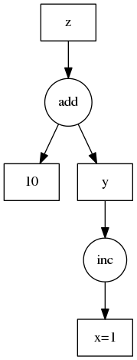
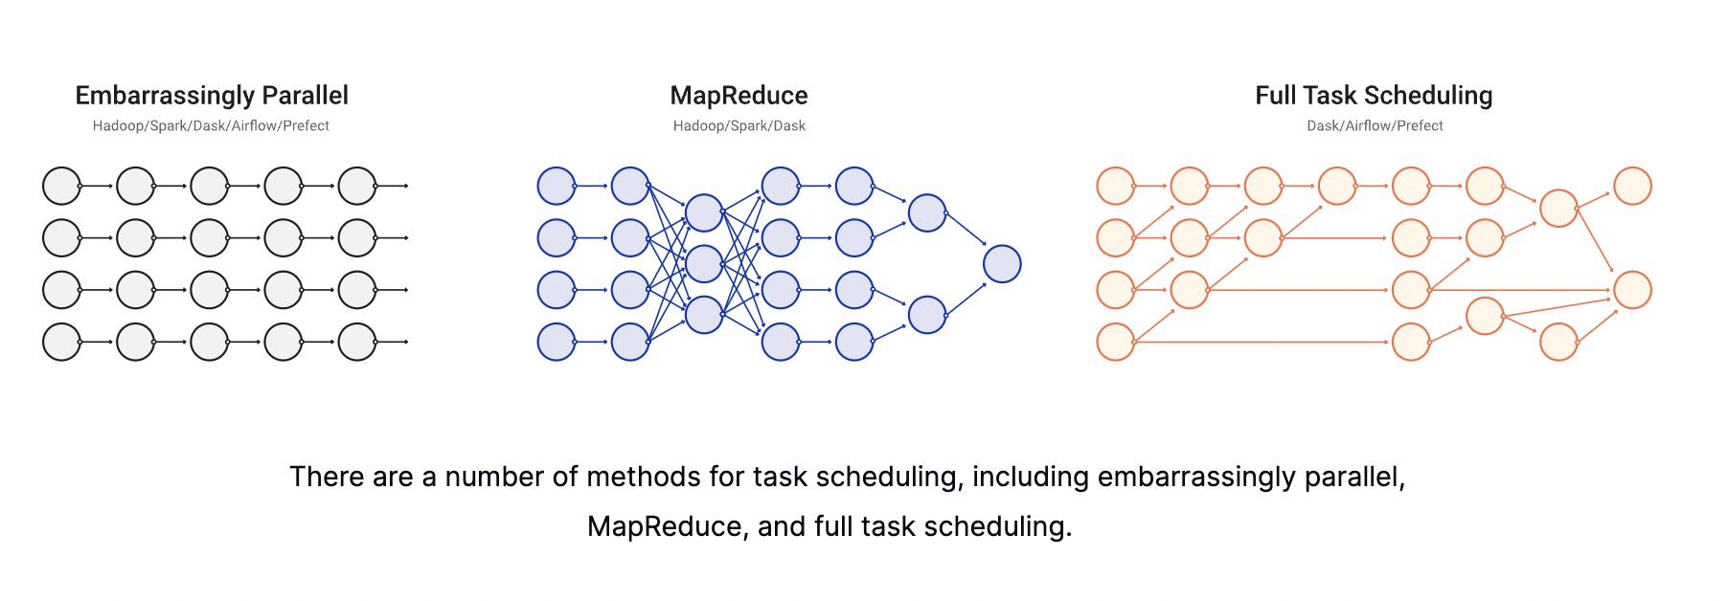
You’ve just built the underlying core concept of dask……
Python is, by nature, procedural
Do line 1, before line 2
Dask and other elements help to snap this procedural dependency, by creating a computation graph and performing parallel computation where possible

Slide 44
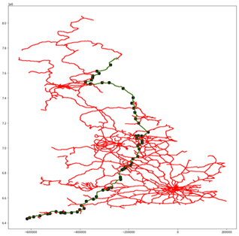
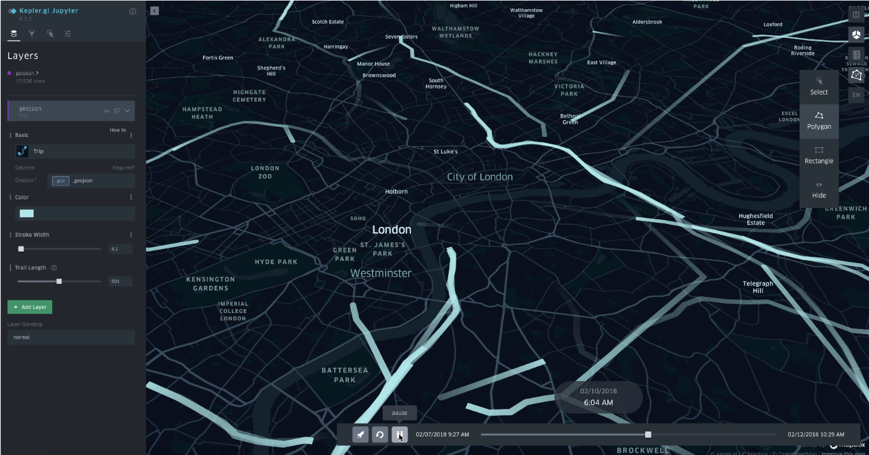
Reducing the Search Space
In my own research…..
Journey of a single train through the grid

Slide 45

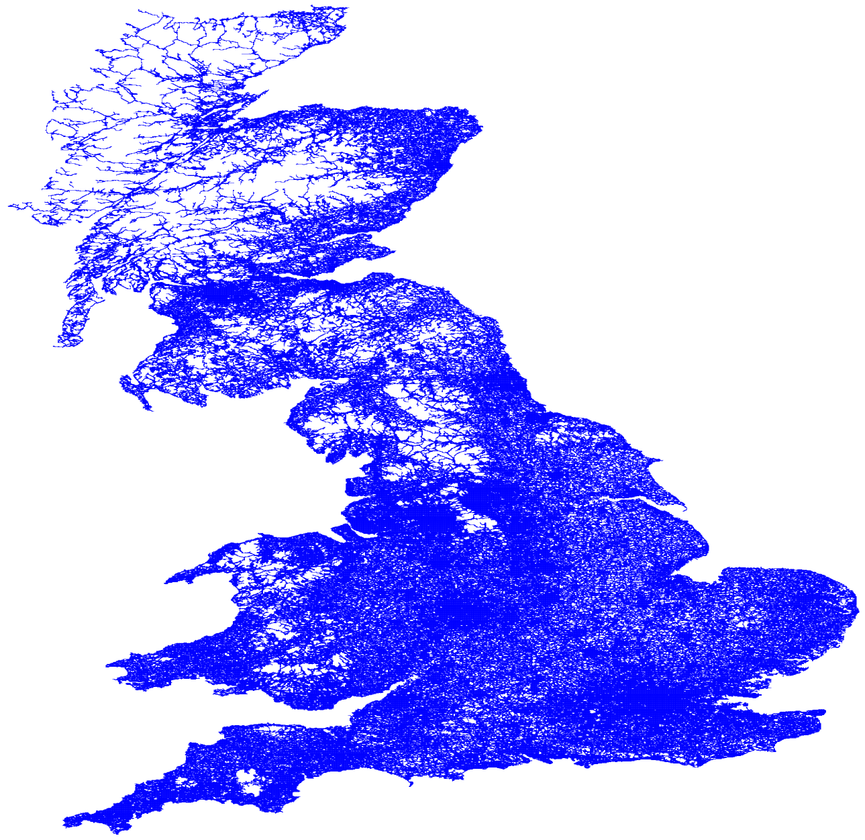
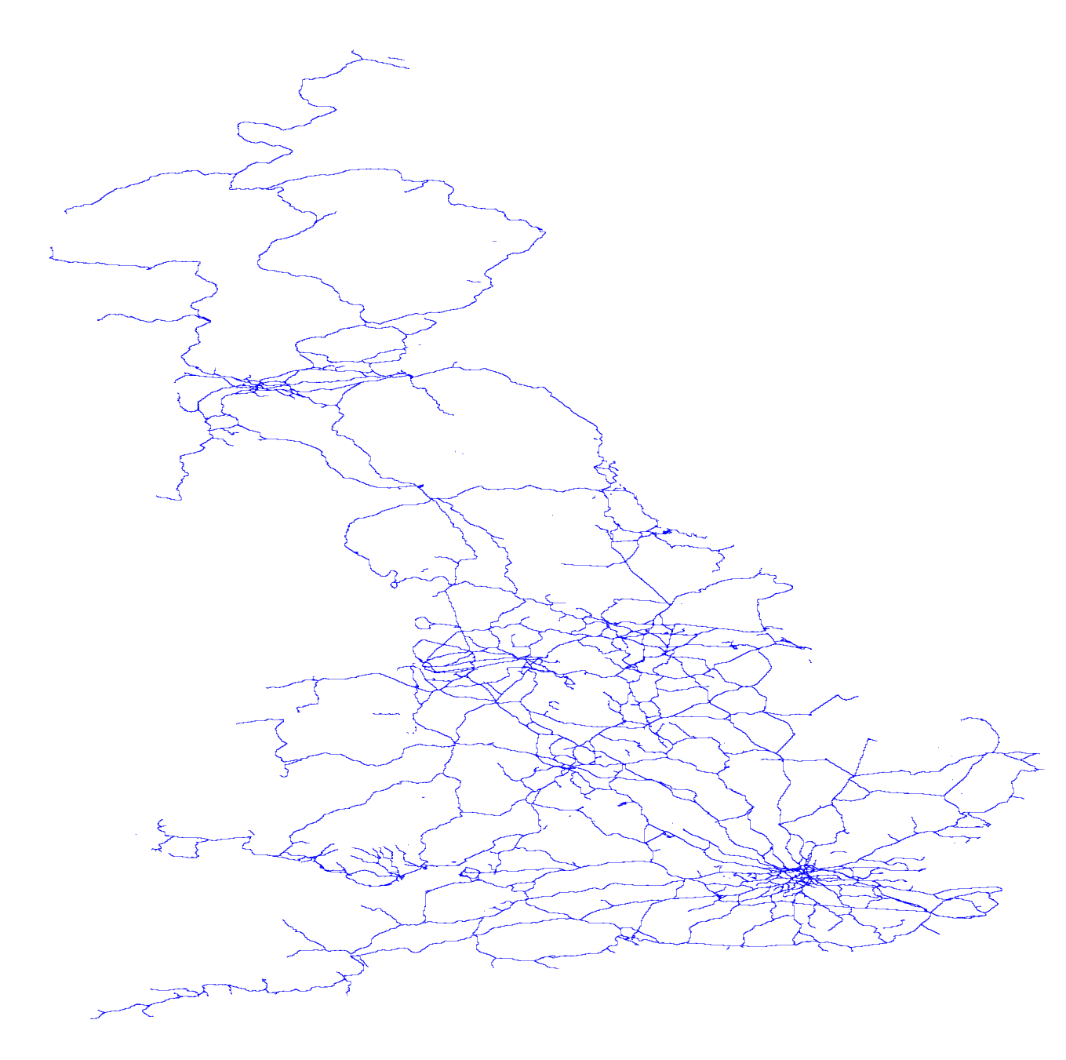

The Idea
Example Grid Structures
A universal framework for agent based simulations of any transport method to determine the movement count through that grid
Extent Grids
Transport Grid (road, rail, ….)
How to represent and build the extent grid network
Road
Rail
All (extent) grids

Slide 46
Pseudocode for network building

Slide 47
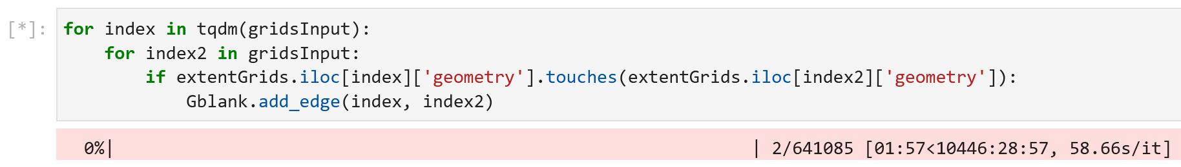
First Version of the code
Iterate through each grid, and then iterate through all other grids, if they touch, then they are connected.
Runtime of 435 days

Slide 48
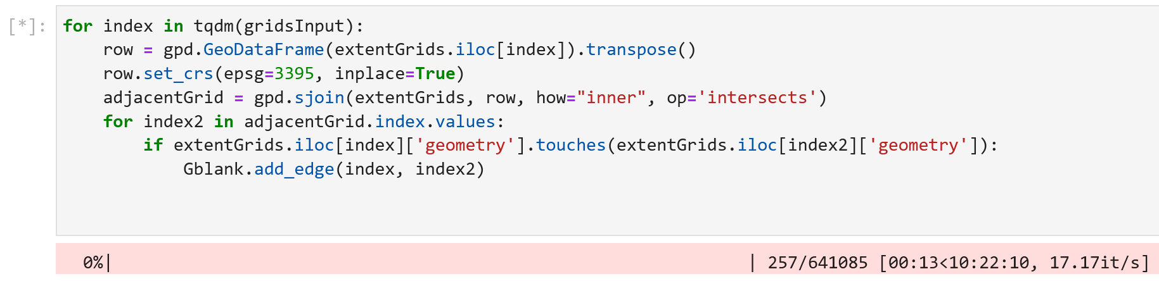
Second Version
Iterate through each grid, find the grids that are within X distance from the centroid, iterate through those grids, if they touch, then they are connected.
Runtime of 10 hours

Slide 49
What has happened to the time complexity between the two algorithms?
Version 1
Version 2

Slide 50
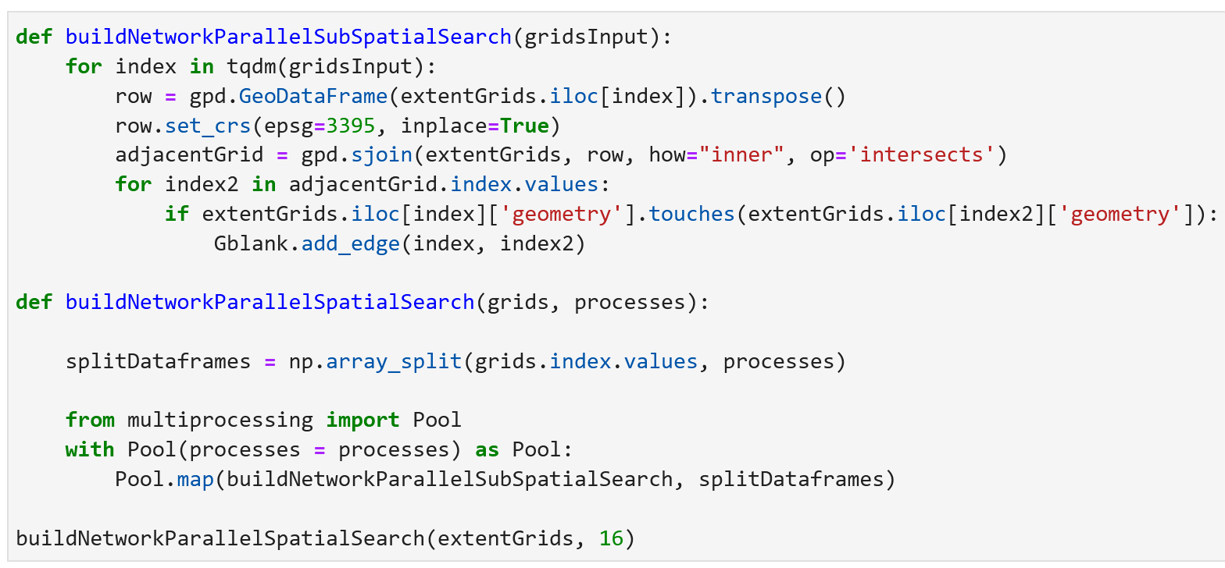
Third Version
Now that we have reduced the search space, it is also possible to parallelize the code, 16 ways (as my desktop has 16 cores), expected runtime of 40 minutes

Slide 51
Overview
First version, with time complexity O(n^2), had a runtime of 435 days
The second version, with time complexity O(n), had a runtime of 10 hours
Allows for the complexity to scale in a manageable fashion as resolution increases
The third version with parallel execution through multiprocessing had a runtime of 40 minutes (or less if you had more cores!)
Allows leveraging a supercomputer

Slide 52
Reducing the search space
Where inventive solutions are ideal
Also, generally, an area where computer scientists aren’t the best, and domain knowledge is most important
Data science isn’t computer science
Try to engage with the CS elements.

Slide 53
Take Aways
Streamline loops
Always ask – Do I need this loop?
No two functions are ever the same
Try to remove dependencies
Temporally
Spatially
Don’t be afraid to rewrite code and start from scratch
Progress isn’t the number of lines of code, but your understanding of the problem

